Slide 1
Genetics in EACirc
Description of the components based on Evolution

Slide 2
The overall picture
Circuit
The circuit is modified in an evolutionary way
Each circuit is evaluated how well it distinguishes true random data from tested data
The aim is to find such a circuit that is a good distinguisher
Evaluate
Evolve

Slide 3
Evaluation of a circuit (1)
Use the circuit to compute results for Test Vectors (TV)
TV = reference (true random) + test data (crypto output)
Number: 1 000x (frequently used) – 100 000x (optimal) TVs
Configurable in config file
Length (input): size of block of output (typically 16 bytes)
Configurable in config file
Length (output): 1 (typically used) – 4 bytes
Configurable in config file

Slide 4
Evaluation of a circuit (2)
Compute the results for all test vectors
Do it twice: true random data & tested data
You get a number (1 000x – 100 000x) of results (1-4 bytes)
Organize the results into categories
Make some resulting values equivalent
Calculate histogram
Evaluate whether the two histograms (random vs. tested) have the same distribution
Final result is a single P-value (float) which is our fitness

Slide 5
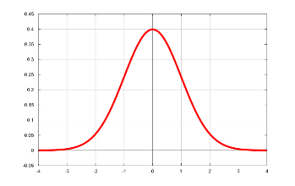
Circuit evaluation
1000 TVs (True Random)
1000 TVs (Tested Data)
The result of the circuit evaluation if a single value in the form of a P-value or fitness (1 - P-value).
1000 results
1000 results
Histogram:
Histogram:
Similar distribution?
P-value

Slide 6
Circuit evolution (high level view)
The aim is to get such a circuit that is able to distinguish true random data from tested data
The smaller P-value the better
Circuit evolution
Set – perform a number of evolution steps
Typically 100 steps (configurable in config file)
For each set a new sequence of TVs is generated
After each set remember the P-value (tested with the new TVs)
After a number of generations analyze uniformity of p-values by a KS test
Generations: 30 000x – 300 000x (configurable in config file)
KS test – test if P-values are uniformly distributed
If KS < 0.01 then the distinguisher WORKS! (and we are happy)

Slide 7
Circuit evolution (high level view)
Total number of generations
1st Set
2nd Set
P-value
P-value
0
1
KS

Slide 8
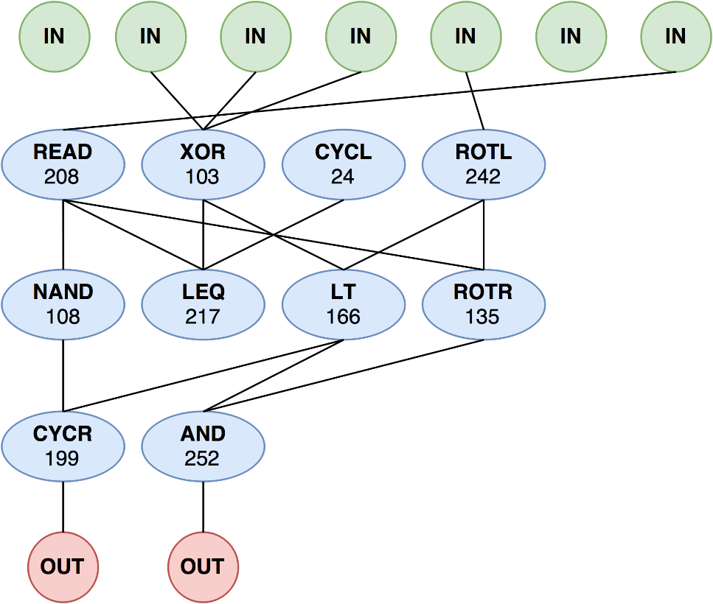
Circuit description
Input data (test vectors)
First layer
Intermediate layers
Last layer
Output data (results)

Slide 9
Circuit dimensions and arity of nodes
Width of a layer: typically 8 (configurable in config file)
Width of the last layer: typically 1 (must be between 1-4)
Total number of layers: typically 5 (configurable in config file)
Arity of nodes (we talk about node inputs here)
First layer: any number & any localization
Intermediate layers: maximum of 4 inputs (config file) & locality restriction
Last layer: any number & any localization

Slide 10
Nodes
Inputs (each 1 byte long)
Function
+
argument
Output (1 byte long)

Slide 11
Node types
NOP
CONS: constant
AND
NAND: AND then NEGATION
OR
NOR: OR then NEGATION
NOT
SHIL: left shift
SHIR: right shift
ROTL: left rotation
ROTR: right rotation
EQ: equals
LT: less than
GT: greater then
LEQ: less or equal
GEQ: greater or equal
BSLC: bit selector
READ: read directly input (of circuit, not node)
JVM sim

Slide 12
Node mutation
Probability of mutation of a node
for each node do the following mutation with the probability of 0.05 (config file):
Add or remove a connection (within connection restrictions)
Change the node function (within restrictions in config file)
Change the node argument (no matter if function is using arg)
Result of the mutation is a valid individual

Slide 13
Crossover
Input: 2 circuits (chosen by a selection strategy)
Output: 1 or 2 circuits as a combination of the input circuits
Two types of crossover supported:
Horizontal (not used)
Vertical (typically used)
Nodes carry their connectors through the crossover

Slide 14
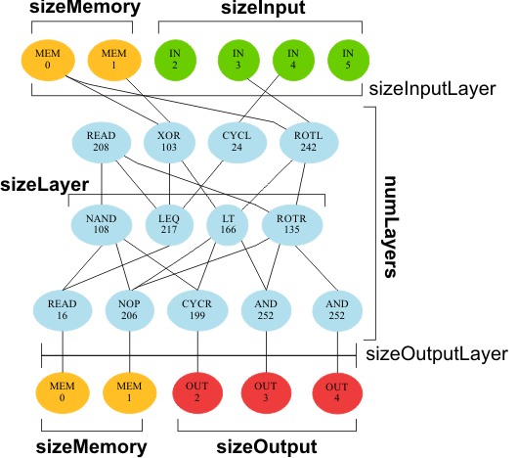
Circuit crossover - vertical

Slide 15
Circuit initialization
First layer
Connections: link each node with an input
Functions: XOR (+ random argument)
Intermediate layers
Connections: 0-4 (random, within the locality restrictions)
Functions and arguments: random
Last layer
Connections: 0-all (random)
Functions and arguments: random

Slide 16
Evolution
Currently used typical parameters
Population: 1
Replacement size: 1
Probability of crossover: 0
Probability of mutation: 0.05
The same for connections, functions and arguments

Slide 17
Genetics
GA algorithm: STEADY STATE
Population size: k; Replacement size: r
Select 2 parents according to a chosen selection strategy (next slide)
Toss a coin whether to copy as is or make crossover (incl. mutation)
Repeat to get r (replacement size) individuals
Now you have k (original) + r (original or crossover) individuals
Perform mutation on the new individuals
Reduce the population towards k elements (replacement strategy)
Select best k elements from k+r elements with respect to the fitness ($1−P‎‑value$) function of the current set of TVs

Slide 18
Parent selection
Roulette selection strategy (typically used)
Take the candidates and spread them in the 0-1 interval
The better fitness of the candidate the larger section of the interval it occupies (not linear scale!)
Generate a random float from 0-1 interval
The candidate occupying the section with the random float wins

Slide 19
Replacement
join the old and new individuals into an temporary population $P_{temp}$ containing k + r individuals
sort the temporary population $P_{temp}$ using quick sort algorithm (unstable sort) according to the fitness of individuals
crop the sorted population $P_{temp}$ to k individuals

Slide 20
EACirc

